Slide 1
Math Game
Week 9 and 10 Progress
By: Gavin Davy, Michael Erickson, and Rena Sakai

Slide 2
SE 2200
Status Report #: | 3 | Date From: | 10/19/20 | Date To: | 11/01/20
Project Title: | Math Game

Slide 3
Team Members:
Team Members
Gavin Davy
Michael Erickson
Rena Sakai

Slide 4
Meeting Minutes Week 9
Date: | 10/19/20 | Time: | 2PM - 3PM
Who Attended? | What was discussed?
Michael | Updated GitHub
Rena | Updated Progress Report
 | Video presentation of progress report - How to do?

Slide 5
Meeting Minutes Week 9
Date: | 10/21/20 | Time: | 2PM - 3PM
Who Attended? | What was discussed?
Gavin | Confirmation of work
Michael | Progress of work
Rena

Slide 6
Meeting Minutes Week 10
Date: | 10/26/20 | Time: | 2PM - 3PM
Who Attended? | What was discussed?
Gavin | Individual progress
Michael | Updated GitHub, Video presentation
Rena | Next meeting

Slide 7
Meeting Minutes Week 10
Date: | 10/28/20 | Time: | 2PM - 3PM
Who Attended? | What was discussed?
Michael | More on individual progress
Rena | Set up time to record video of progress report

Slide 8
Meeting Minutes Week 10
Date: | 11/01/20 | Time: | 6PM - 7PM
Who Attended? | What was discussed?
Michael | Video presentation of progress report
Rena

Slide 9
Action Items Week 9 and Week 10
Action Items | Summary of Progress
Update/create buttons | Started.
Link screens with buttons | Will continue to be in progress, as new screens are created
Get final screen uploaded | Gavin will upload when completed.
Create video of Progress Report for extra credit | Sunday, November 1st at 6PM

Slide 10
This Weeks Accomplishments
Team Member | Description of task | Hours Spent | Problems Encountered & Solutions
Rena | linked stop button and stop page and changed layout | 3 hours
 | put background to stop page and changed layout | 1 hour | https://duckduckgo.com/?q=android+studio+backgrou+d+chage&iax=videos&ia=videos&iai=https%3A%2F%2Fwww.youtube.com%2Fwatch%3Fv%3DTEYMSwzfFqQ
 | update Github | about 20 min
Michael | Update and consolidate GitHub | 3 hours
 | Create additional links between screens | 3 hours

Slide 11
Project Submissions
Individual Group Work

Slide 12
Contributions from Gavin

Slide 13
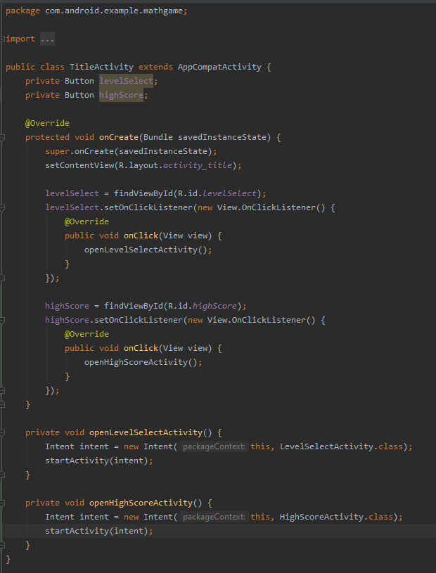
Contributions from Michael
Links from Title screen to both Level Select and High Scores has been finished.

Slide 14
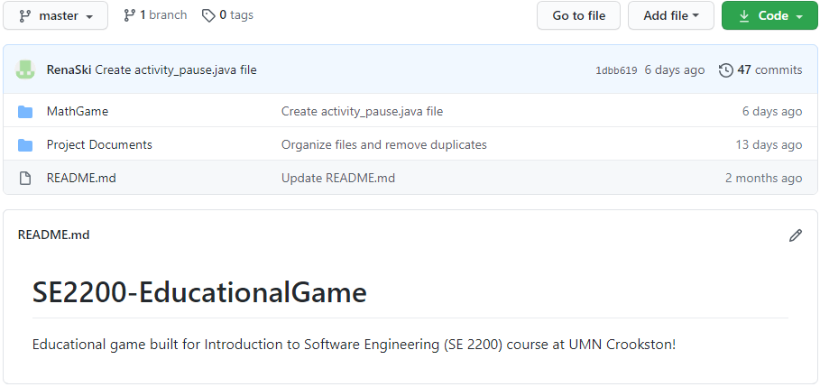
Contributions from Michael
GitHub has been updated and is now more organized. All .xml and .java files have been merged into a single project folder, which can be loaded in Android Studio.
Files have been updated to include proper naming for screens, buttons, references, etc.

Slide 15
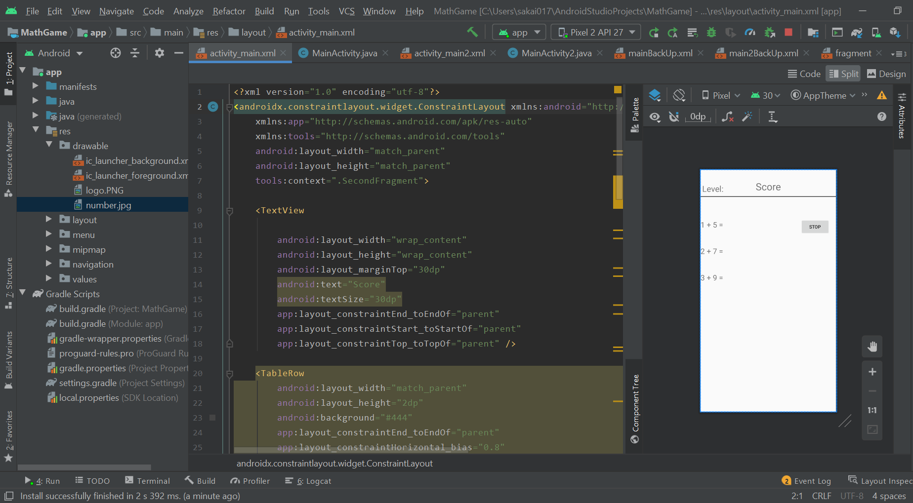
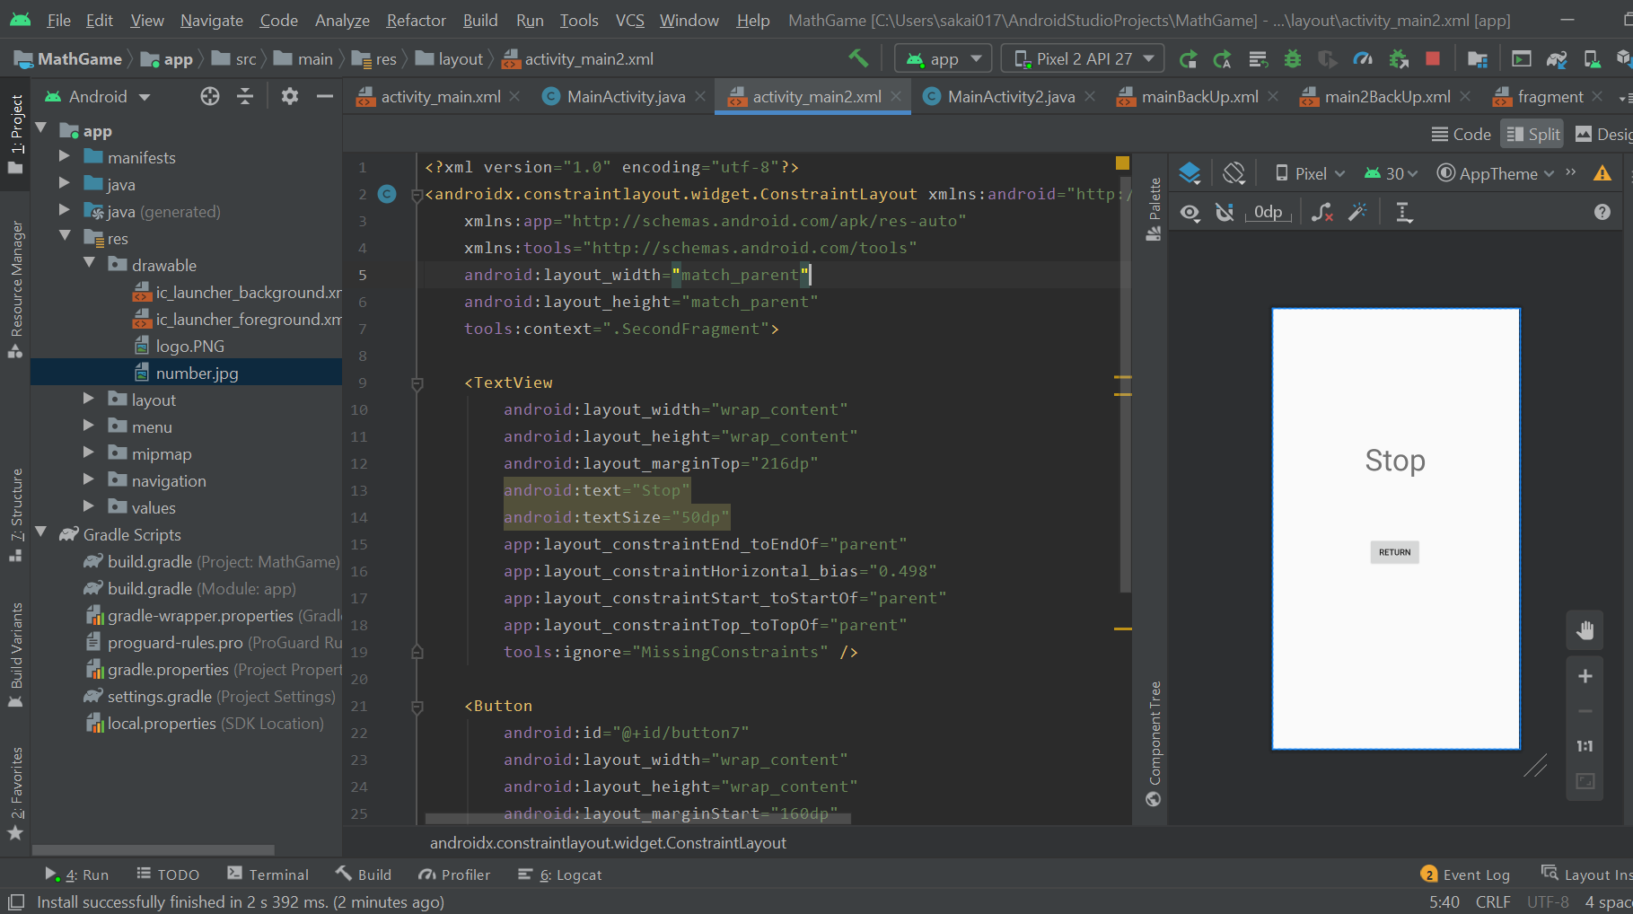
Contributions from Rena
I connect between a stop button and a stop page. Also, I connected between the stop button and a score page. I can go back and forth between the score page and the stop page with the push of a button.

Slide 16
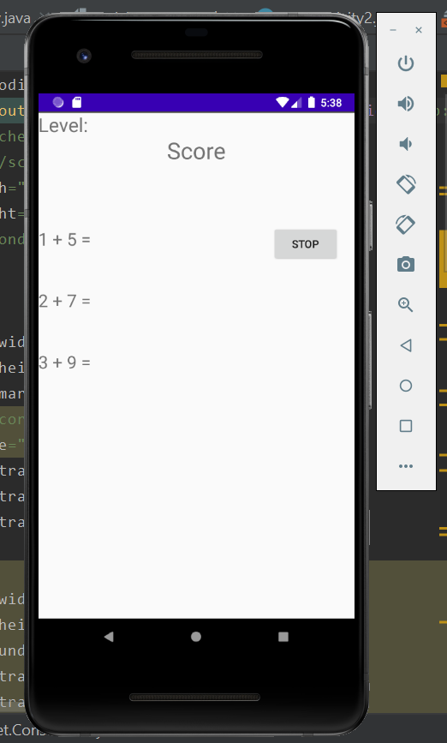
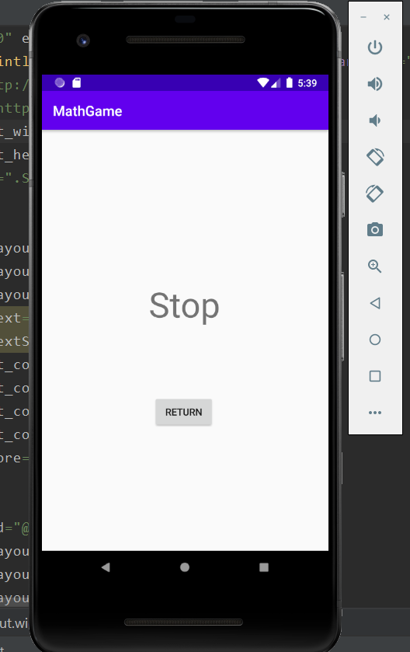
Contributions from Rena
These pictures show when I run the android emulator.

Slide 17
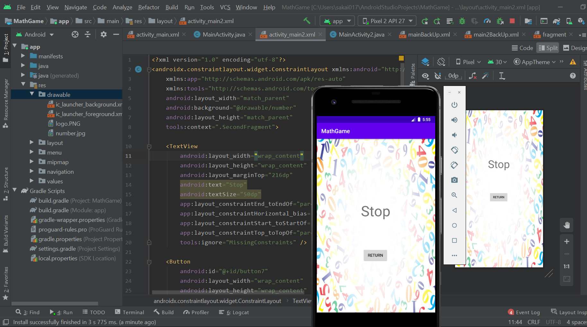
Contributions from Rena
I updated the stop page with some background.

Slide 18
Next Two Weeks’ Plans:
Finish app screens
Decide on naming conventions
Begin coding to allow user input on appropriate screens
Resolve errors in project folder (names for referenced files and files in incorrect locations, e.g. .java files in layout folder)

